Slide 1
CS535: Algorithm Design and Analysis
Minimum-Cost Flows
Prof. Zane Yu
Department of Computer Science
University of Wisconsin, Milwaukee
April 30, 2024

Slide 2
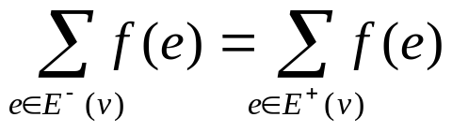
Review: Flow Network
A flow f for a network N is an assignment of an integer value f(e) to each edge e that satisfies the following properties:
  Capacity Rule: For each edge e, 0 ≤ f (e) ≤ c(e)
  Conservation Rule: For each vertex v ≠ s,t
  where E⁻(v) and E⁺(v) are the incoming and outgoing edges of v, resp.
Example:
v
1/3
2/6
1/1
3/7
t
s
3/3
w
1/1
2/9
4/5
3/5
u
2/2
z

Slide 3
Flow Network with Costs
A flow network N with a cost w defined on each edge:
  (V, E, C, W, s, t), where c and w are non-negative integers.
Example:
  The first integer represents the capacity
  The second integer represents the cost
v
3, 1
6, 2
1, 3
7, 4
t
s
3, 5
w
1, 0
9, 6
5, 7
5, 3
u
2, 2
z

Slide 4
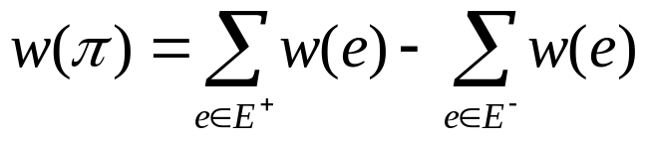
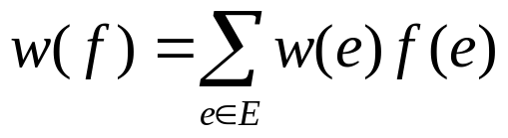
Minimum-Cost Flows
The cost of a path:
where E⁺ and E⁻ are forward and backward edges respectively on the path.
The cost of a flow:
where E is the edges of the network.
The minimum-cost flow problem: Find a maximum flow that has the lowest cost over all maximum flows.

Slide 5
Augmenting Cycles
An augmenting cycle with respect to flow f is an augmenting path whose first and last vertices are the same.
Adding the flow of an augmenting cycle to an existing flow does not change the flow value
Example:
u
u
1/1,3
1/2,1
0/1,3
1/2,1
s
0/3,1
t
s
1/3,1
t
1/2,1
1/1,3
2/2,1
1/1,3
v
v
|f| = 2 and w(f) = 8 |f| = 2 and w(f) = 7

Slide 6

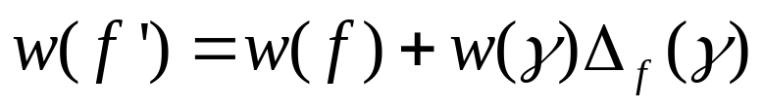
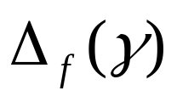
Properties of Augmenting Cycles
Lemma: Let be an augmenting cycle for flow f in network N, there exists a flow f’ for N such that |f’|=|f| and:
is the residual capacity of the cycle
Theorem: A flow f has minimum cost among all flows of value |f| if and only if there is no augmenting cycle of negative cost with respect to f.

Slide 7
Algorithm of Finding Minimum-Cost Flows
Find the maximum flow f* using the Ford-Fulkerson algorithm → O(|f*|(n+m))
Check if f* has a negative cost augmenting cycle
(this can be done using the Bellman-Ford algorithm)
→ O(nm)
If found, augmenting the cycle to the current flow and repeat (2 & 3)
(note: this does not change the flow value but it reduces the cost by at least 1)
Else, stop.
Running time: O(w*nm), where w* is the total cost of the maximum flow f*.

Slide 8
Successive Shortest Paths
An alternative way of finding minimum-cost flows is to start from an empty flow and build up to a maximum flow by a series of augmentations along minimum-cost paths.
Theorem: Let f be a minimum-cost flow, and let f ’ be the flow obtained by augmenting f along an augmenting path of minimum cost. Then flow f ’ is also a minimum-cost flow.

Slide 9
A New Algorithm of Finding Minimum-Cost Flows Based on Successive Shortest Paths
Start from an initial empty flow
Find an augmenting path of minimum cost
Augment the path found to the current flow
Repeat (2)(3) until no augmenting path is found.
The key here is to find an augmenting path with minimum cost. This can be done using Residual Graphs and Bellman-Ford algorithm (see next)

Slide 10
Residual Graphs
The first value is the residual capacity
u
u
2/2,1
1,3
0,1
0/1,3
Every edge generates two new edges
0,-3
2,-1
s
2/3,1
t
s
2,-1
1,1
t
For forward edge: w’ = w
For backward edges: w’ = -w
0,1
1,3
2/2,1
0/1,3
2,-1
0,-3
v
v
Continue to the next round
Simplify (removing edges of zero residual capacity)
u
u
3
-1
1,3
2,-1
s
-1
1
t
s
1,1
t
2,-1
Apply Bellman-Ford algorithm to find the augmenting path of minimum cost
-1
3
2,-1
1,3
v
v

Slide 11
Analysis
Generating and simplifying the residual graph takes O(m)
Applying Bellman-Ford algorithm takes O(nm).
Each iteration (one augmentation) increases the flow value by at least one (remember the capacity and cost are both non-negative integers)
The total number of iterations (see slide #9) is at most |f*|, where f* is the maximum flow.
Running time: O(|f*|nm). Not really better than the original algorithm on slide #7 !

Slide 12

Can We Do Better?
Yes, we can apply Dijkstra’s algorithm instead of Bellman-Ford to find the minimum cost of the residual graph. Therefore, running time becomes O(|f*|mlogn).
However, we have to make sure the edge weights are non-negative, as required by Dijkstra’s algorithm
Here is what we do:
define a distance function d(v) for each vertex v as the minimum weight of a path from the source s to v. Then we define a new weight for each edge in the residual graph as follows:
where w(u,v) is the weight in the original residual graph.
Then we can prove that the new weights are always non-negative

Slide 13
Example
2
u
u
0/1,3
0/2,1
0/1,3
0/2,1
Dijkstra’s algorithm
s
0/3,1
t
s
0/3,1
t
3
O(mlogn)
0
0/2,1
0/1,3
0/2,1
0/1,3
v
v
1
Generate Residual Graph Rf
O(m)
u
u
1,1
2,0
Generate new Residual Graph Rg
O(m)
1,3
2,-1
s
2,0
1,0
t
s
1,1
t
2,-1
Then, Dijkstra’s algorithm to find the shortest path
2,0
1,1
2,-1
1,3
v
O(mlogn)
v

Slide 14

Extra Slides

Slide 15
Bellman-Ford Algorithm
Algorithm BellmanFord(G, s)
for all v ∈ G.vertices()
if v = s
setDistance(v, 0)
else
setDistance(v, ∞)
for i ← 1 to n-1 do
  for each e ∈ G.edges()
  u ← G.origin(e)
  z ← G.opposite(u,e)
  r ← getDistance(u) + weight(e)
  if r < getDistance(z)
  setDistance(z,r)
  for each e ∈ G.edges()
  u ← G.origin(e)
  z ← G.opposite(u,e)
  r ← getDistance(u) + weight(e)
  if r < getDistance(z)
  print "negative-weight cycle found"
Works with negative-weight edges
Must assume directed edges (for otherwise we would have negative-weight cycles: a cycle between only two nodes)
Iteration i finds all shortest paths that use i edges.
Running time: O(nm).

